Slide 1
Here Today – Gone Tomorrow:
Strategies for Motivating and Retaining
Adult Learners
Kathy Olson
(614) 529-6665
kdo3@cornell.edu

Slide 2
Do you ever ask yourself these questions?
  Why do students drop out rather than complete an adult education program?
  What caused them to enroll at this particular moment in the first place?
  How can student retention be increased in our adult education classes?

Slide 3

Why don’t our students
stick around longer?
How do we keep our students around long enough for them to make gains and achieve their goals?

Slide 4
Supports and Barriers
What do you think supports learners in their persistence? | What do you think hinders learners in their persistence?

Slide 5
Indicators of Persistence
  ☐Gender ☐Immigrant status
  ☐Working hours ☐Goal
  ☐Age of children
  ☐Employment status
  ☐Negative school experience
  ☐Parent's education
  ☐Involvement in previous training
  ☐Single parent status

Slide 6
Adult Student Characteristics
That Support Persistence
Immigrant status, age over 30, and parent of teen or adult children
Involvement in previous efforts at basic skills education, self study, or vocational skill training
Specific goal

Slide 7
Adult Student Characteristics
That Did Not Influence Persistence
Gender and ethnicity
Single parent status
Employment status/working hours
Negative school experience
Parent's education

Slide 8
Supports for Learner Persistence
Managing
Positive and Negative Forces
Building
Self-
Efficacy
Clear
Goals
Progress
Self/assisted management to overcome persistence
barriers Sponsors:
Family
Friends
Teachers
Students
Feeling that student will be successful in adult education and obtain his/her goal
Set reachable goals; Decide on instructional objectives that must be met to reach goals
Measures that are meaningful to the student; student can see the progress he is making
John Comings et al. (2004)

Slide 9
Establish long and short term goals
  Provide opportunities for students to become familiar with options for further education or work.
Read the work of John Commings and Kegan

Slide 10
Intake and Orientation
Retention begins at intake, and sets the tone for the rest of the student’s experience. (Quigley 1998)
The first 3 weeks are the most critical for the student’s identifying and resolving barriers to continued participation. Barriers include:
  Institutional
  Situational
  Attitudinal (Quigley 1998)

Slide 11
Teacher behaviors
Be responsible for knowing about your students’ lives
Expect the most: Avoid a deficit model
Implement curriculum that is meaningful to the students
Question and reflect on your teacher behaviors

Slide 12
Build community
The building of relationships among learners is linked with increased persistence and learning gains. (Kegan, 2001).
“A close-knit learning community provides a psychological and physical holding environment which greatly increases persistence” (Cuban)
Cohort groups provide emotional, psychological, and physical support to adult learners and challenge them to broaden their perspectives. (Kegan )

Slide 13
Create a safe learning environment
Set up a buddy system
Provide rewards and recognition

Slide 14
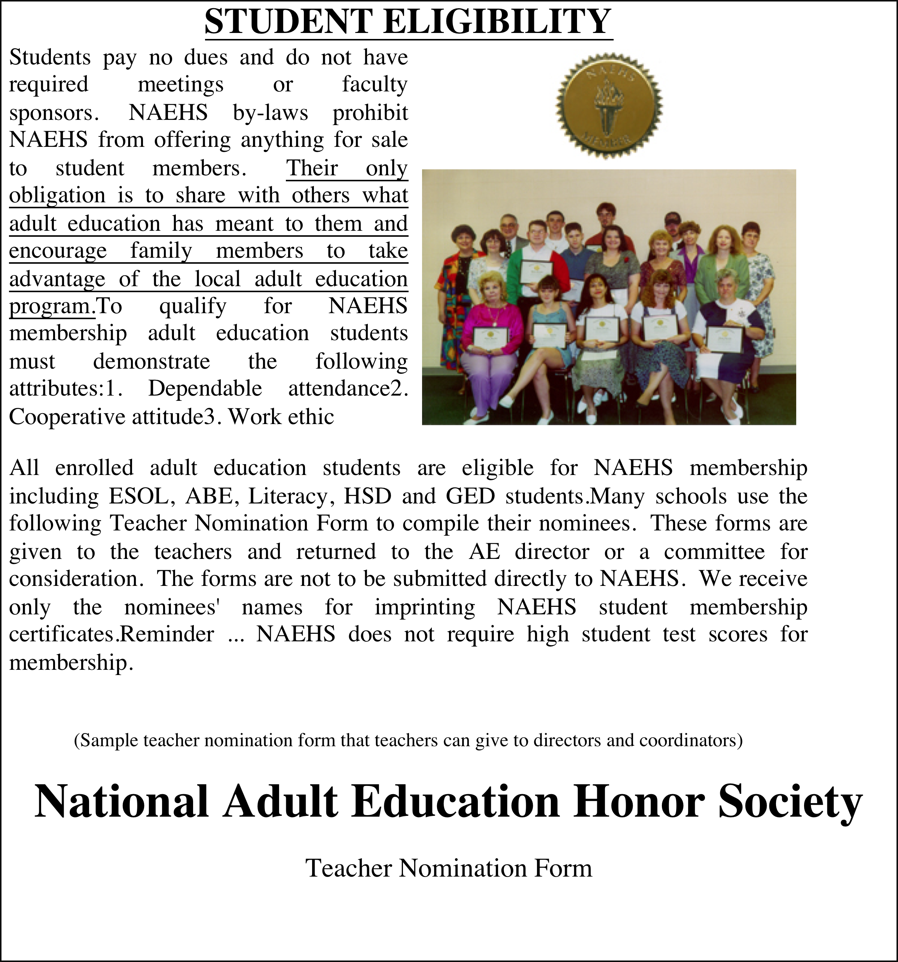

Slide 15
All enrolled adult education students are eligible for NAEHS membership including ESOL, ABE, Literacy, HSD and GED students. Many schools use the following Teacher Nomination Form to compile their nominees. These forms are given to the teachers and returned to the AE director or a committee for consideration. The forms are not to be submitted directly to NAEHS. We receive only the nominees' names for imprinting NAEHS student membership certificates.
National Adult Education Honor Society
Teacher Nomination Form
Teacher___________________________Nominee_____________________________
Membership Standards
Attendance by attending class regularly, which means: 1. Arrives on time, and 2. Is consistently present
Briefly describe nominee’s attendance record: __________________________________ ________________________________________________________________________
Cooperation by working harmoniously with teachers and fellow students, which means: 1. Respects other’s ideas and values, 2. Participates actively, 3. Speaks in turn, and 4. Demonstrates patience.
Briefly describe nominee’s attendance record: __________________________________ ________________________________________________________________________
Work ethic while performing education related tasks which means: 1. Comes to class prepared, 2. Completes homework, 3. Sets goals and follows through, 4. Listens with understanding, 5. Asks questions and seeks help, 6. Takes responsibility for own learning.
Briefly describe nominee’s work ethic: ________________________________________
________________________________________________________________________
Teacher: I nominate the named individual as an NAEHS member for the reasons stated above. This person meets all membership qualifications and I believe him/her to be an outstanding ambassador for adult education.
Signature_______________________________________

Slide 16
Show Progress
Write goals as statements of ability
Checklist of things student can do in native language and in English
  ask for sewing supplies at store
  check a book out of the library
  tell the cashier you were charged the wrong amount
  watch movies
  sing a song

Slide 17
Encourage Students to Purchase Their Textbooks
Encourage Practice Outside of Class

Slide 18
What are you doing to build self efficacy?
Five strategies
  Student leadership
  Assessment
  Recognition
  Learner-generated materials
  Learning styles and special learning needs
Are you doing anything in your class or program related to any of these strategies? If so, jot them down.

Slide 19
Progress
Assessment Strategies
  Use a variety of methods to allow students to see their progress (e.g., portfolios, checklists, technology-based tracking mechanisms)
  Train students in self-evaluation procedures
  Conferencing
  Dialogue journals
  Portfolios

Slide 20
Open Enrollment
Lack of need to be present each day results in low attendance rates and slower progress. (Beder, 2005)
Students’ motivation to attend open enrollment classes is less because they believe they won’t be missing anything they can’t do the next time they attend. (“Oregon Shines” p. 72)
“In addition, it (open enrollment) often means that there are few serious consequences for learners with poor attendance....” or coming to and leaving class at odd times. Open enrollment may produce disincentives to attendance. (Snow and Strucker)
High retention classes’ students report that they felt they missed something important if they didn’t come to class (Jarrell, 2003)

Slide 21
The challenge for educators:
Find ways to:
  help students identify the negative forces that make it difficult for them to attend class;
  provide students with strategies to deal with those negative forces so that they can stay in school as long as possible;
  provide students with materials they can use for self-study during a stopping out period; and
  provide students with the impetus to return to the program as quickly as possible once the negative forces have diminished.

Slide 22
Things to Read
Learner Persistence in Adult Basic Education: CALPRO Research Digest Sandra Kerka This research digest synthesizes key persistence-related research, including less familiar studies, and focuses on the implications for practice.
Persistence: Helping Adult Education Students Reach Their Goals John Comings For an in-depth overview of adult learner persistence, this article provides a literature review, a full discussion of the NCSALL Learner Persistence study, and commentary on the implications for policy, research, and practice.
Drago-Severson, Helsing, Kegan, Popp et al., 2001
www.pearsonlongman.com/ae/download/adulted/persistence.pdf
otos.library.uu.nl/publish/articles/000176/bookpart.pdf
[PDF]
Persistence in English as a Second Language (ESL) Programs ...
www.nald.ca/library/research/sticht/31jan05/31jan05.pdf

